Slide 1
Detecting Pre Training Data From LLMs

Slide 2
Introduction
This paper studies the pretraining data detection problem:
Given text and black-box access to a model, with NO knowledge of its pre training data, can we determine if the model was pre-trained on the text.
There is a huge lack of transparency in releasing data sources on which LLMs are trained

Slide 3
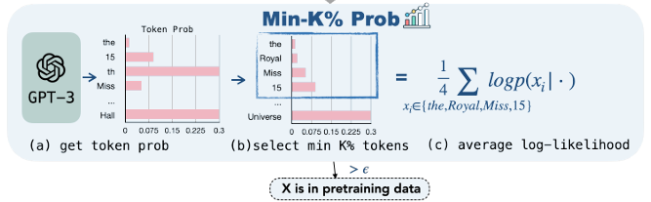
Min-K% Probability
Min-K% Prob - this determined whether a text X is in the pretraining data of an LLM
Compute The model generates probabilities for each token in the input text X
These probabilities indicate how likely the model is to generate each token in the sequence.
If a text is in the training data, the model has learned it well and assigns high probabilities even to the least likely tokens.
If a text is unseen, the model struggles with certain tokens, leading to a lower log likelihood for them.

Slide 4
Problem Definition and Challenges
Definition of MIA: Given a language model fθ and its associated pre training data D = {zi}i∈[n] sampled from an underlying distribution D, the task objective is to learn a detector h that can infer the membership of an arbitrary data point x: h(x,fθ) → {0,1}.
Challenge 1: Unavailability of Pre-Training Data
Approaches assume that the detect can access (1) the distribution of the target model’s training data, and (2) a sufficient number of samples from the shadow data are used to train a calibration model
Challenge 2: Detection Difficulty
Pre Training and fine tuning are significantly impacted when the amount of data and compute needed increases.
Determining whether an example is part of a training dataset becomes challenging of the different outputs are similar

Slide 5
WikiMIA - Evaluation Benchmark for MIA
Data Construction: Data is constructed by filtering Wikipedia pages and their stop words to narrow it down to assess whether a model was pretrained on the related data.
Benchmark Setting: MIA needs to be able to recognize texts that are paraphrased and edited as well
MIA evaluations utilize different length data in evaluation which can impact the difficulty of detection.

Slide 6
Experiments
Evaluate the performance of Min-K% Prob and baseline detection
Baseline Detection Methods:
LOSS Attack Method - predicts membership of an example based on the loss of the target model when fed into the example as input
In the context of Language Models (LMs), this loss is associated with perplexity (PPL), which is a measure of how well the model predicts the next token in a sequence. Higher perplexity indicates the model is less confident in its prediction. - comparing the loss (perplexity) of a given example to a threshold to decide if the example is part of the training set.

Slide 7
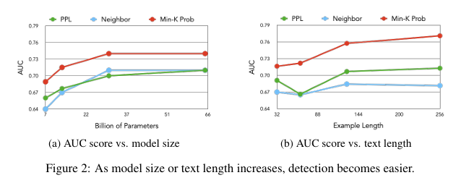
Figure
The AUC score of different methods increases when text length increases, because longer texts have more memorized information by the target model. Therefore, it is easier for the model to recognize a member vs non member

Slide 8
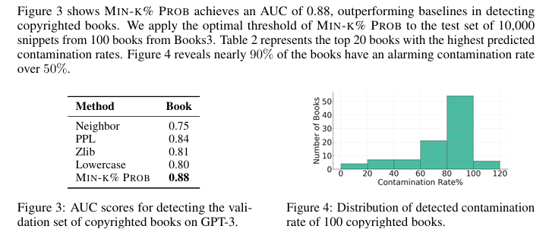
Case Study 1: Detecting Copyrighted Books
Validation Set: 50 book known to be memorized by Chat GPT
Negative Examples: Books published post 2023, knowing that Chat would NOT be trained on these.

Slide 9
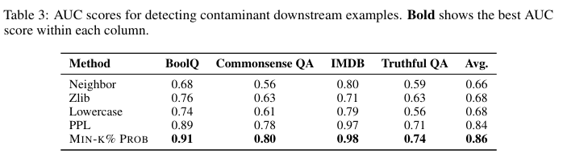
Case Study 2: Detecting Downstream Dataset Contamination
Goal: The goal is to simulate leakage from downstream tasks into pre training data, which could happen in real-world settings where some data from the specific downstream task is inadvertently included in the pretraining phase.

Slide 10
Results
AUC scores increase when pre-training dataset size increases.
Models better memorize outliers, so it is easier to recognize non-member versus member data
Enhanced memorization: enables easier detection with perplexity based metrics.
Learning Rate: raising the learning rate increases AUC scores in downstream taks, meaning higher learning rates causes models to memorize their pre training data more strongly
Overfits to data

